Slide 1


Facing Troubles during Library Preparation and Sequencing Run
ARTIC Network Train the Trainer - August 2022
ARTIC TRAIN 12AUG22
Anna Kovalenko

Slide 2
Keep an eye out & Troubleshooting What do we mean the sample was successfully sequenced?
virus abundance varies sample-to-sample, storage conditions and extraction methods may differ in ability to obtain complete genomes
low virus abundance in samples may have amplification artifacts, low coverage may lead to consensus errors
Contamination! The sequencing protocol is highly multiplexed and has many amplification cycles - all this increases risk of cross-contamination

Slide 3
Keep an eye out & Troubleshooting By what criteria do we expect samples to be successfully sequenced?
samples Ct values
storage conditions for samples and reagents not violated (extremely important)
clean extraction (extremely important)
avoid contamination (extremely important):
carefully handling samples and reagents;
change gloves;
use 1-5% sodium hypochlorite solution (bleach) followed by 70% Ethanol to minimize the risk of nucleic acid contamination, plus ultraviolet (UV) irradiation;
keep reagents separately;
always separate zones and equipment for clean-, pre- and post PCR step;
prepare/aliquot new and fresh Master Mixs and any work solutions you need for each experiment.
use Negative Controls to control contamination (extremely important)

Slide 4
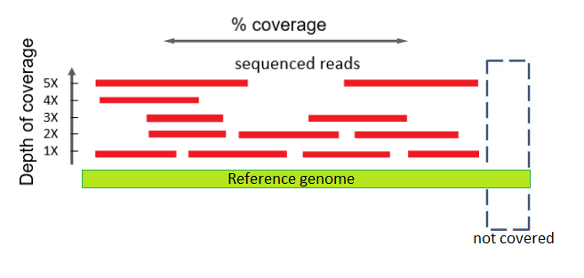
Keep an eye out & Troubleshooting Issues during library preparation:
Contamination investigation (QC your sequencing experiment)
Check the Negative Controls:
with Qubit (PCR post-clean up concentration)
gel electrophoresis?
Monitor mapped reads for Negative Controls in RAMPART:
during the run (real-time)
after stopping the run again start RAMPART!
Note: RAMPART analysing in real time need min 4000 reads to be processed to be appeared on the screen.
5 reads
1 read

Slide 5
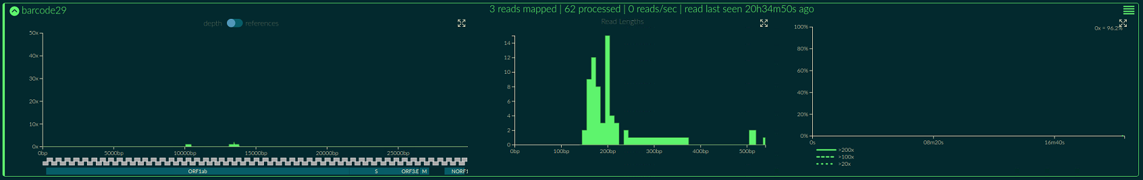

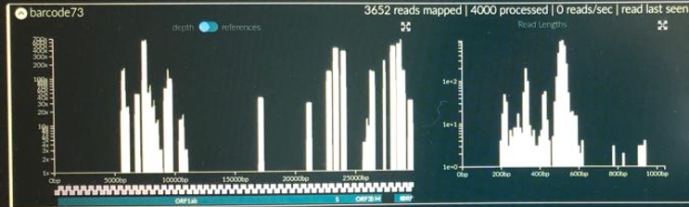

Keep an eye out & Troubleshooting Issues during library preparation:
Contamination investigation
Record mapped reads for Neg Controls in your Seq Sample Validation excel sheet!
Threshold checkpoint for the mapped reads in the Neg Controls:
No need to continue with the assemble if ≥100 mapped reads
Proceed to assembly if <20 mapped reads, or if 20-99 mapped reads but at <20X depth coverage at all sites

Slide 6
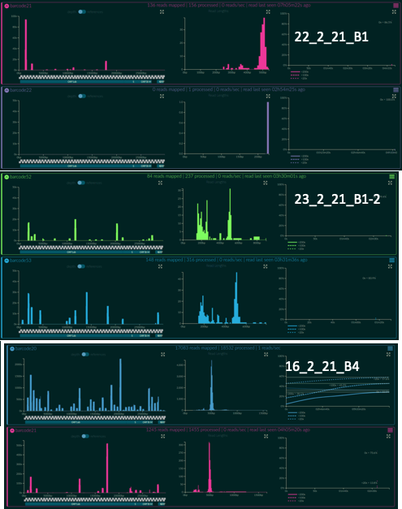
always track and monitor cross-contamination using nuclease-free water and carrying these controls through the all library prep steps
Always include minimum 2 Negative Controls in one batch – i.e.,
Extraction Neg Control
Neg Control at the RT step
batch 1
2 Negatives:
Neg#1 – 156 reads mapped
Neg#2 – 0 reads mapped
batch 2
2 Negatives:
Neg#1 – 84 reads mapped
Neg#2 – 148 reads mapped
batch 3
2 Negatives:
Neg#1 – 17063 reads mapped
Neg#2 – 1245 reads mapped

Slide 7
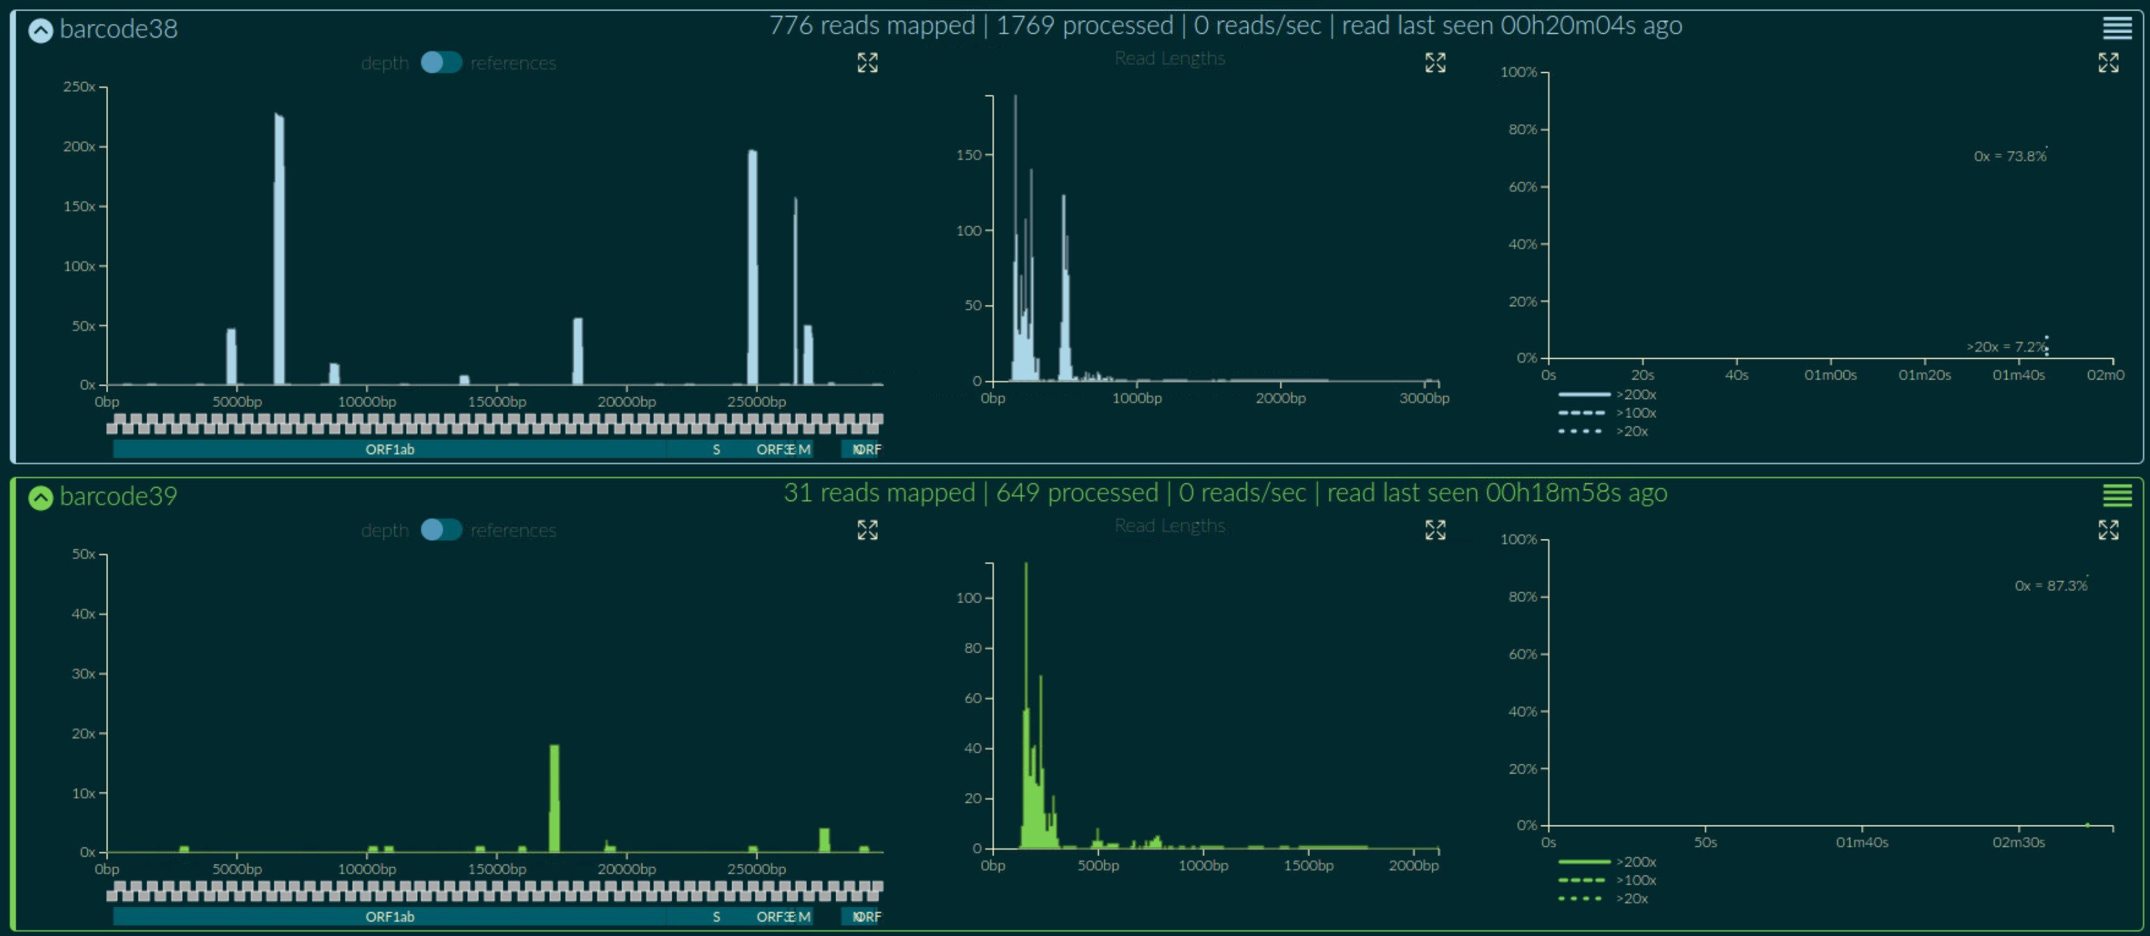
Exercise: Do you proceed to assembly this run (batch)? Why?
Threshold checkpoint for the mapped reads in the Neg Controls:
No need to continue with the assemble if ≥100 mapped reads
Proceed to assembly if <20 mapped reads, or if 20-99 mapped reads but at <20X depth coverage at all sites
Monitor contamination in RAMPART: Both Negatives from the same seq run (batch)
776 reads mapped
31 reads mapped

Slide 8
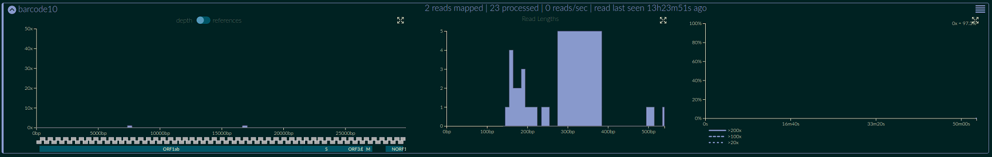
Exercise: Do you proceed to assembly this run (batch)? Why?
Threshold checkpoint for the mapped reads in the Neg Controls:
No need to continue with the assemble if ≥100 mapped reads
Proceed to assembly if <20 mapped reads, or if 20-99 mapped reads but at <20X depth coverage at all sites
Monitor contamination in RAMPART: Both Negatives from the same seq run (batch)
3 reads mapped
2 reads mapped

Slide 9
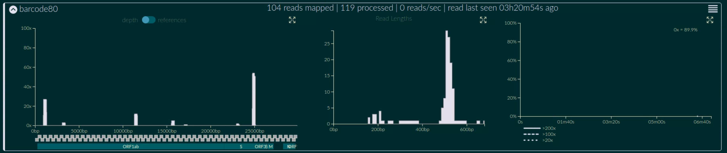
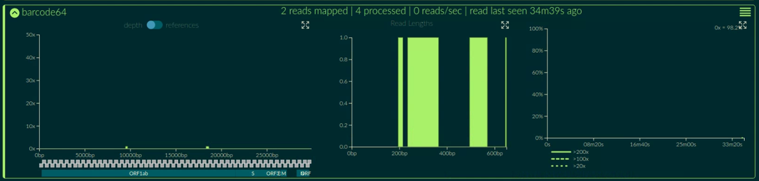
Exercise: Do you proceed to assembly this run (batch)? Why?
Threshold checkpoint for the mapped reads in the Neg Controls:
No need to continue with the assemble if ≥100 mapped reads
Proceed to assembly if <20 mapped reads, or if 20-99 mapped reads but at <20X depth coverage at all sites
Monitor contamination in RAMPART: Both Negatives from the same seq run (batch)
104 reads mapped
2 reads mapped

Slide 10
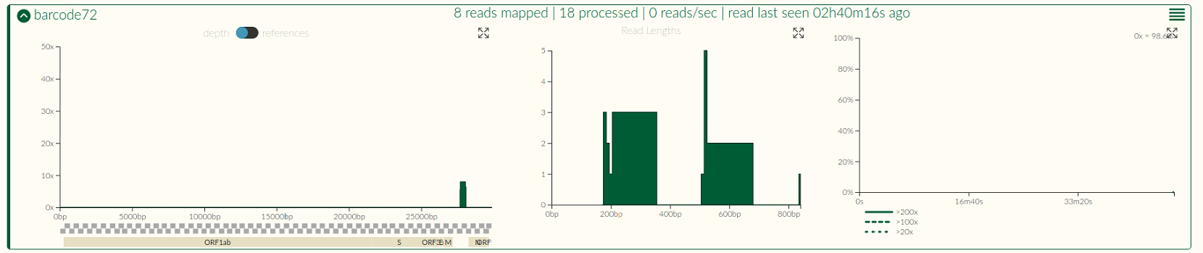
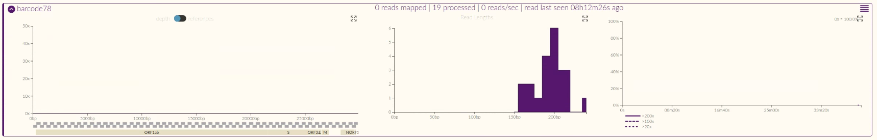
Exercise: Do you proceed to assembly this run (batch)? Why?
Threshold checkpoint for the mapped reads in the Neg Controls:
No need to continue with the assemble if ≥100 mapped reads
Proceed to assembly if <20 mapped reads, or if 20-99 mapped reads but at <20X depth coverage at all sites
Monitor contamination in RAMPART: Both Negatives from the same seq run (batch)
8 reads mapped
0 reads mapped

Slide 11
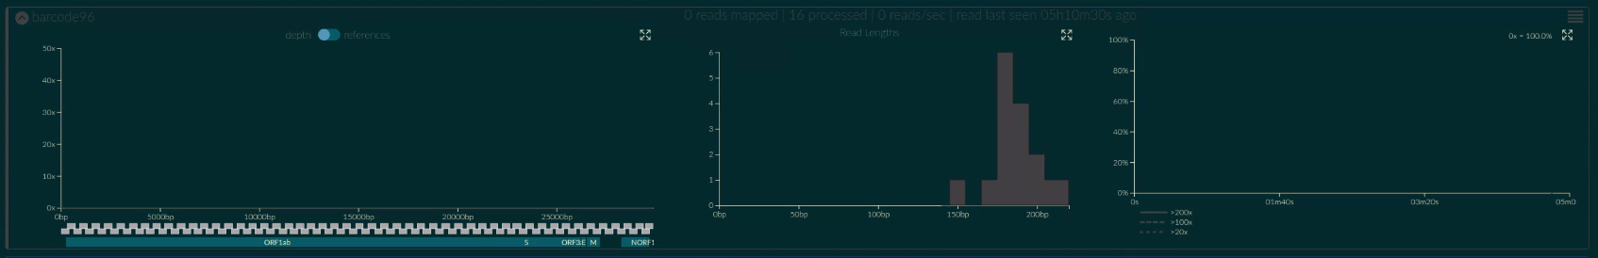
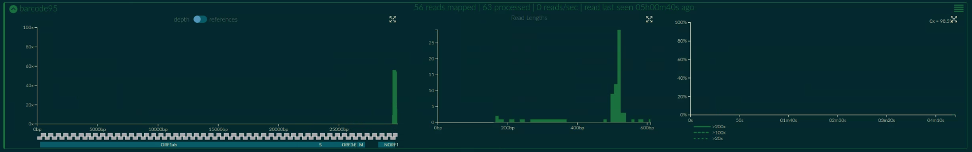
Exercise: Do you proceed to assembly this run (batch)? Why?
Threshold checkpoint for the mapped reads in the Neg Controls:
No need to continue with the assemble if ≥100 mapped reads
Proceed to assembly if <20 mapped reads, or if 20-99 mapped reads but at <20X depth coverage at all sites
Monitor contamination in RAMPART: Both Negatives from the same seq run (batch)
0 reads mapped
56 reads mapped

Slide 12
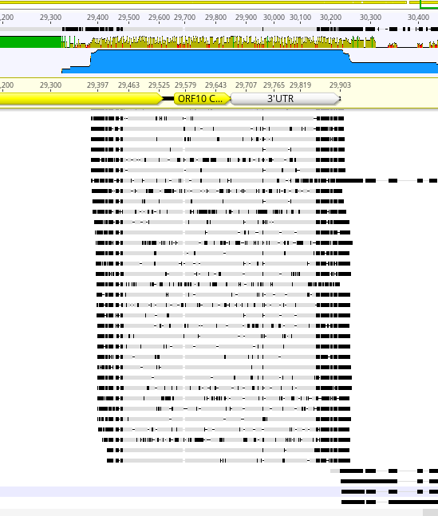

56 mapped reads at one site – single amplicon (#99) but at 50X depth coverage (threshold: less than 20X)
No need to continue with the assembly
Start a new experiment! Because it was Extraction Control – Start with new extraction!

Slide 13
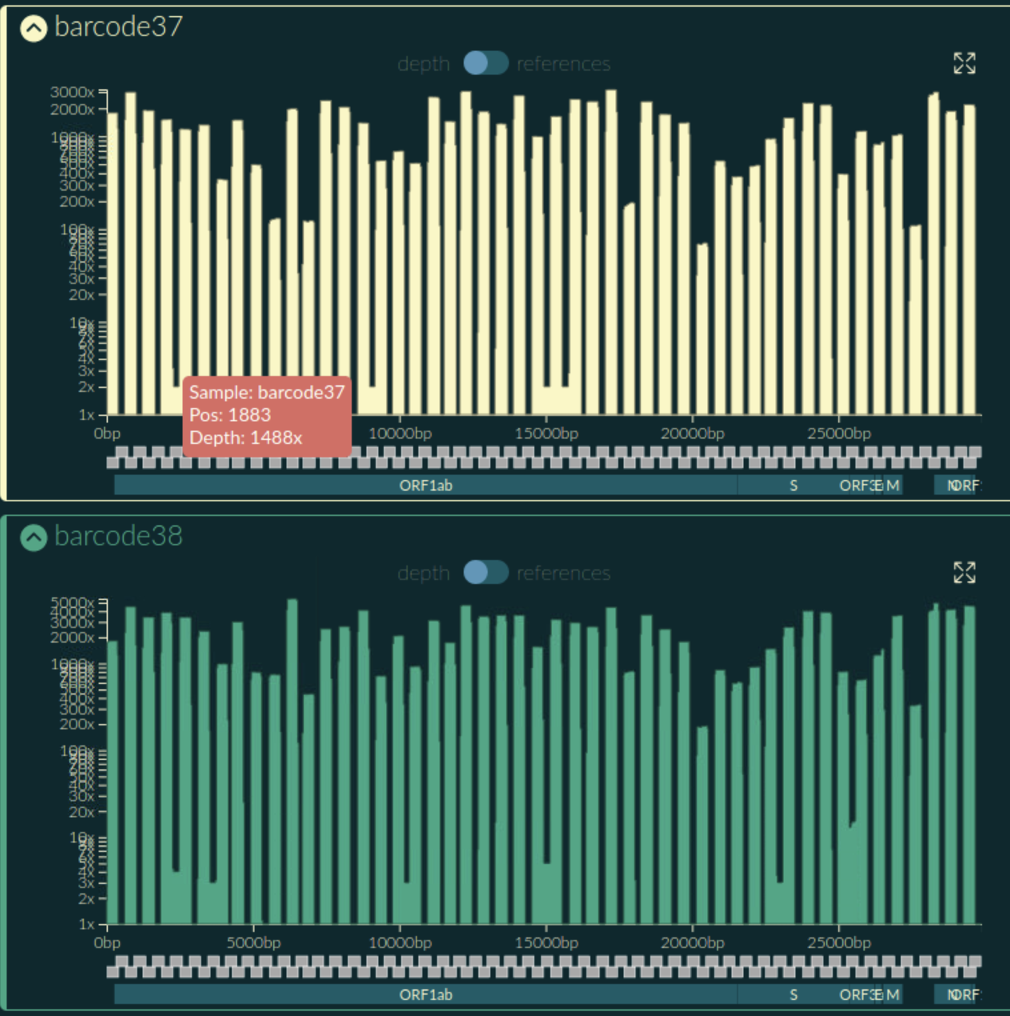

Keep an eye out & Troubleshooting Issues during library preparation:
The missing pool
forget to use Pool 2 (B)
or added Pool 1 (A) two times
coverage depth
amplicon & SARS-CoV2 genome position

Slide 14
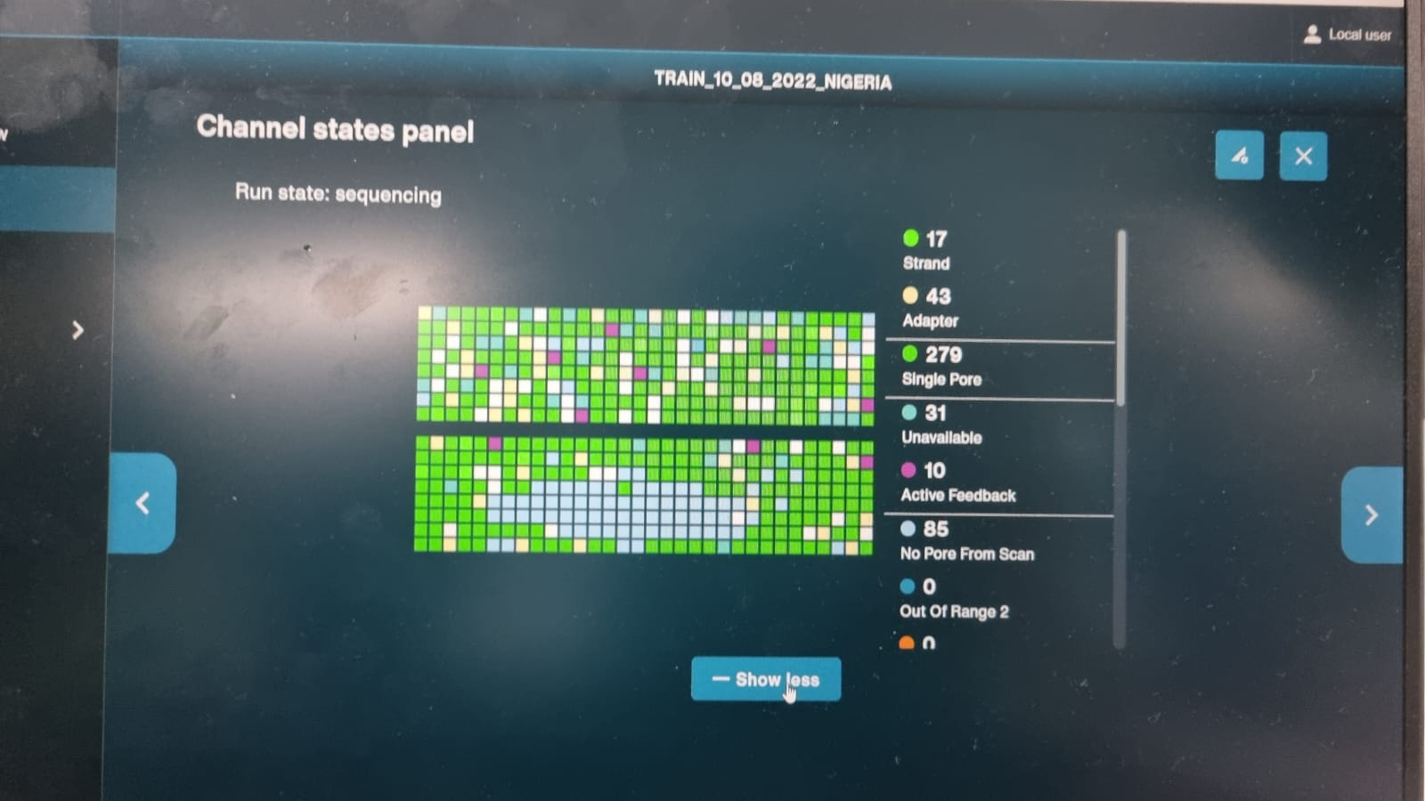
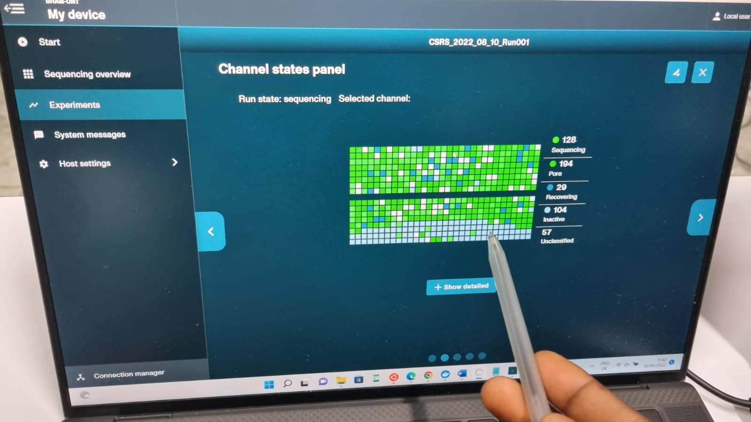
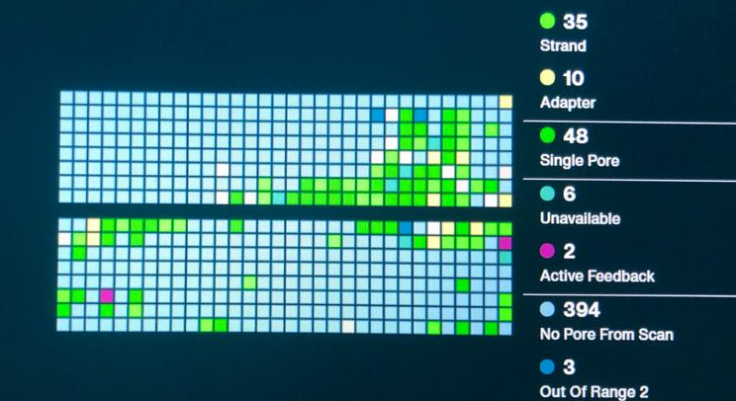

Keep an eye out & Troubleshooting Issues during the sequencing run:
Large proportion of inactive pores
(shown as light blue in the channels panel and duty time plot)
Possible Why?
Air bubbles have been introduced
contaminations in the library damaged or blocked the pores
okay
bad
catastrophe
Notes:
Air bubbles introduced through flow cell priming and library loading can damage or kill the pores. After the Flow Cell Check it is essential to remove any air bubbles near the priming port before priming the flow cell.
Contaminants are present in the sample. The pore count during the Flow Cell Check is performed using the QC DNA molecules present in the flow cell storage buffer. At the start of sequencing, the library itself is used to estimate the number of active pores. Because of this, variability of about 10% in the number of pores is expected. A significantly lower pore count reported at the start of sequencing can be due to contaminants in the library that have damaged the membranes or blocked the pores. Alternative extraction or purification methods may be needed to improve the purity of the input material.

Slide 15

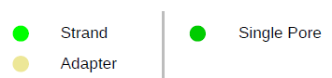
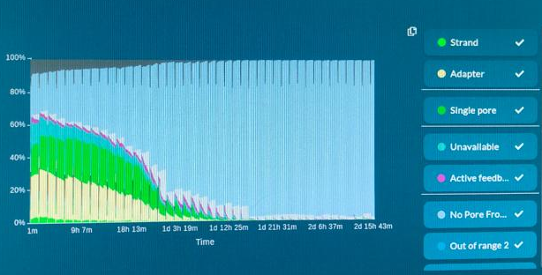
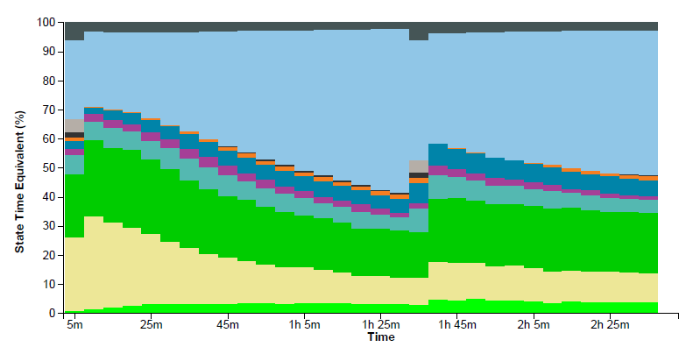
Keep an eye out & Troubleshooting Issues during the sequencing run:
Pore occupancy close to 0.
Why?
sequencing adapters did not ligate to the amplicons (i.e., enzymes died due to inadequate storage condition)
ethanol was used at the wash step after sequencing adapter ligation (Ethanol can denature the motor protein on the sequencing adapters)
no tether was added to the Priming Mix during flow cell priming (FLT tube).
Notes:
Lambda control library can be prepared to test the integrity of the third-party reagents.
Make sure FLT was added to FB before priming.

Slide 16
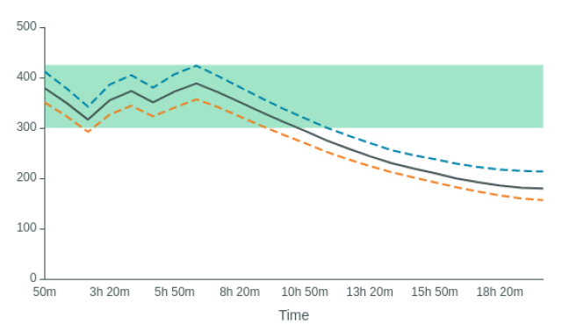
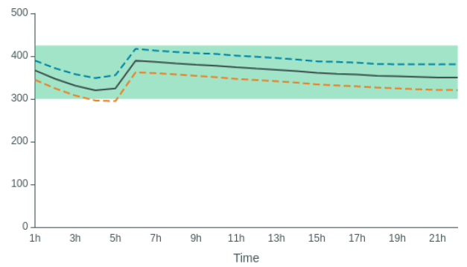
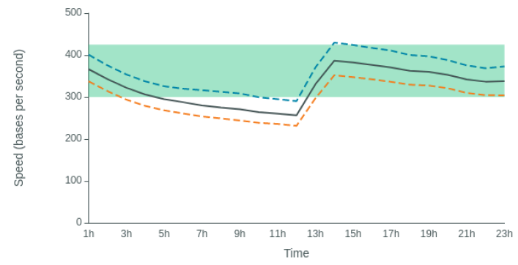
Keep an eye out & Troubleshooting Issues during the sequencing run:
Reduction in sequencing speed later into the run
If the DNA translocation speed drops below 300 bases per second, you may start to see a reduction in quality of data
very overloaded
Why?
Fast fuel consumption is typically seen when the flow cell is overloaded with library
(~5–50 fmol of library is recommended)
after refuel
Actions to do:
Pause the run
Refuel: load 250 µl of the Priming Mix into the flow cell via the priming port (not the SpotON port), avoiding the introduction of air bubbles
after refuel

Slide 17
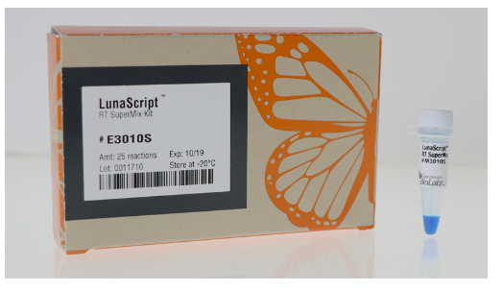
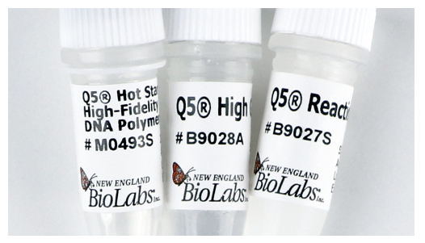

Third-party reagents for Library Prep: (1000 samples)
RT PCR step:
Reagent | Supplier | Library Step | Contents
1) Lunascript RT Super-mix | New England BioLabs | RT | Ready-to-use mix
2) Q5 Hot Start High-Fidelity Master-mix | New England BioLabs | PCR | Q5 Polymerase, and Q5 buffer
3) dNTP Solution Mix | Thermo Fisher |  | Ready-to-use
Primer Set (Artic V4.1) |  | Primer sets (A & B) to go (collect on today)
Lunascript RT Super-mix
Q5 Hot Start High-Fidelity Polymerase
dNTP Solution Mix

Slide 18
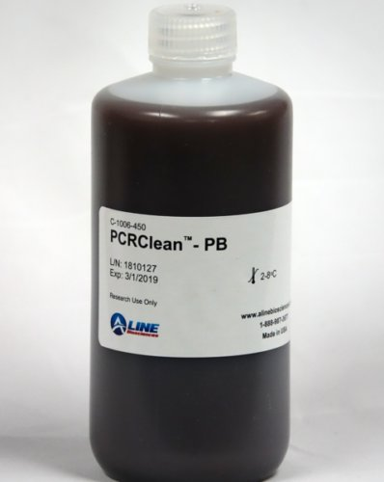
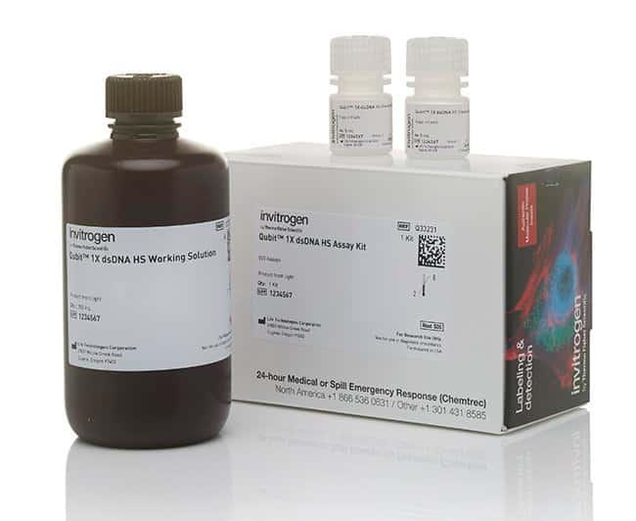
Third-party reagents for Library Prep: (1000 samples)
SPRI clean up step & Qubit quantification:
Reagent | Supplier | Library Step | Contents
1) PCR Clean - DX | Aline BioSciences | SPRI clean up | Bottle of magnetic beads
2) Qubit 1X dsDNA HS Assay Kit-500 assays | FisherScientific | Qubit quantification | Dye mix and controls
magnetic beads
Dye mix and standards

Slide 19
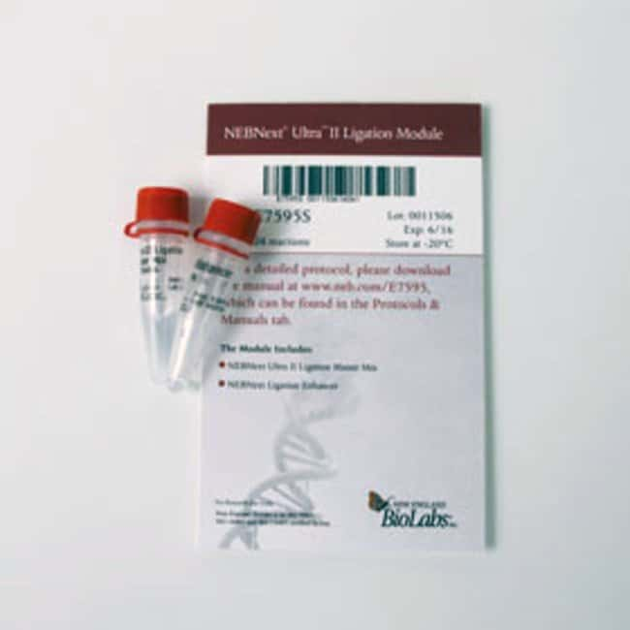
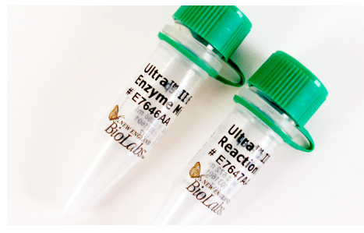
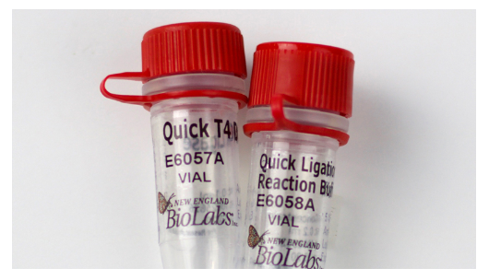
Third-party reagents for Library Prep: (1000 samples)
End Prep / Barcode Ligation / Adapter Ligation:
Reagent | Supplier | Library Step | Contents
1) NEBNext Ultra II End Repair/dA-tailing module | New England BioLabs | End-Prep | Enzyme mix and Buffer mix
2) NEBNext Ultra II Ligation module | New England BioLabs | Barcode Ligation | Ready-to-use mix
3) NEBNext Quick Ligation Module | New England BioLabs | Adapter Ligation | Quick T4 ligase, and 5x Buffer
End Prep reagents
Adapter Ligation reagents
Barcode Ligation

Slide 20


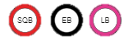

ONT reagents for Library Prep: (1000 samples)
Reagent | Library Step | Contents
1) Native Barcoding Expansion 1-96 | Barcode Ligation | 96well-Plate with barcode, and Adapter mix (AMII)
2) Native barcoding 1-12 |  | Barcodes in tubes and Adapter Mix (AMII)
3) Native barcoding 13-24 | Barcode Ligation | Barcodes in tubes and Adapter Mix (AMII)
4) Short Fragment Buffer Expansion | Library SPRI Clean up | SFB
5) Sequencing Auxilary vials | Library Loading | SQB, EB, LB
6) Flow Cell Priming Kit | Priming step | FB and FLT

Slide 21

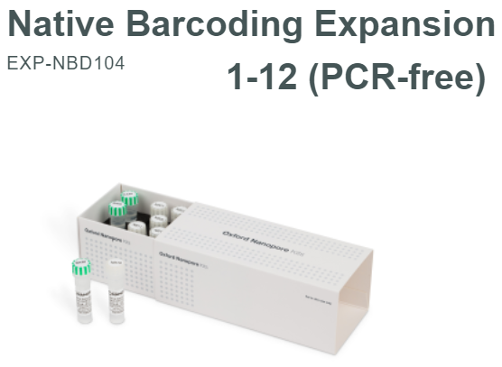


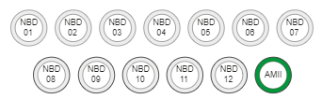
Dilute your barcode plate:
add 56ul MQ in each well (use multichannel pipette)
use 3ul per reaction

Slide 22
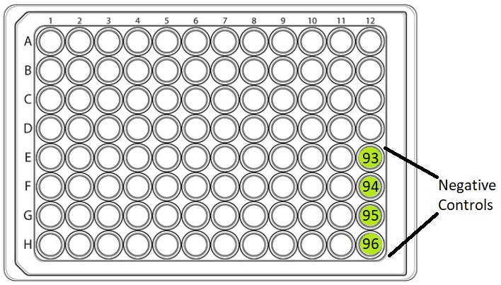
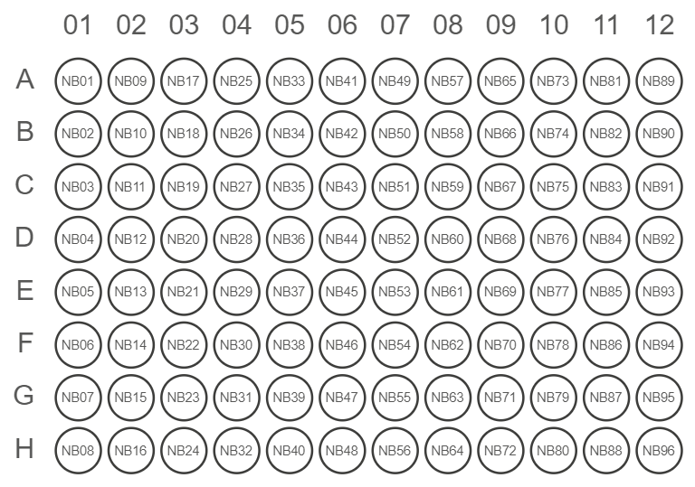
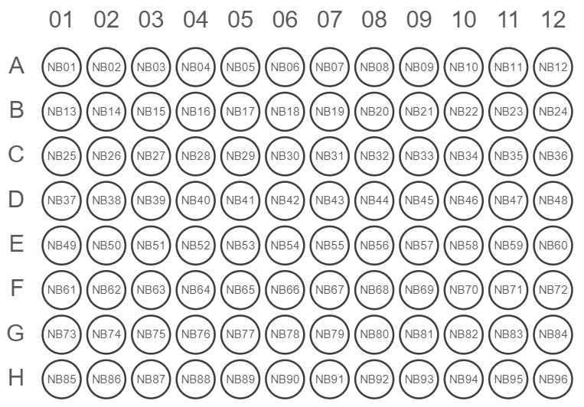
Keep an eye out & Troubleshooting Issues during library preparation:
Sample Plate
Barcode misarrangement
Native Barcoding Expansion 96 (EXP-NBD196) contents
Kits in batches NBD196.10.0007 onwards have barcodes ordered in columns on the plate:
Kits in batches prior to NBD196.10.0007 have barcodes ordered in rows:

Slide 23
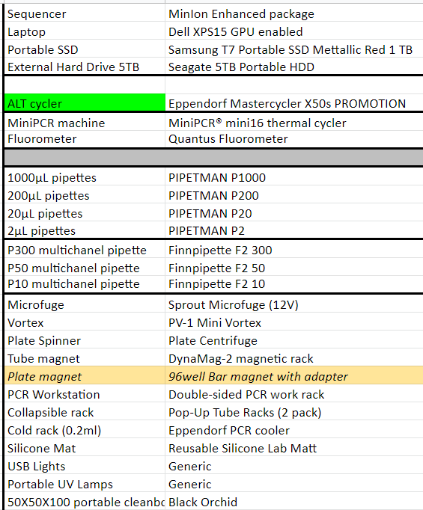
Equipment
You will receive:

Slide 24
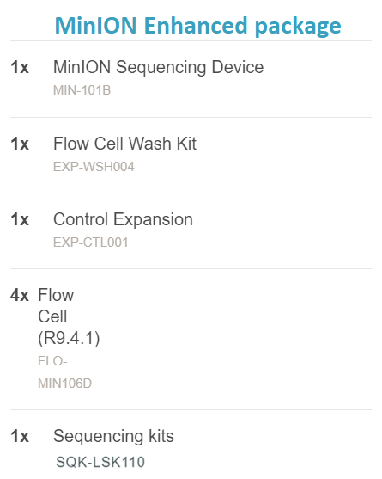
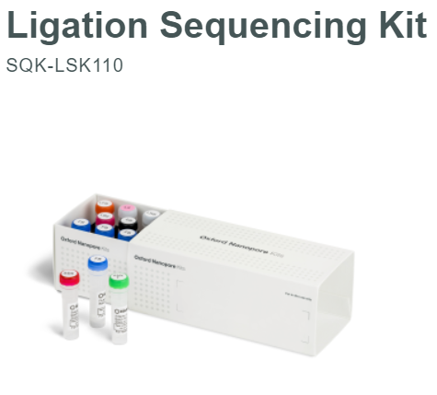

contains Lambda DNA (LMD)

Slide 25
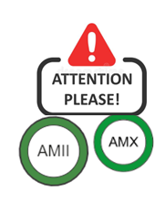
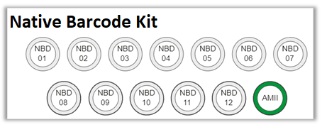
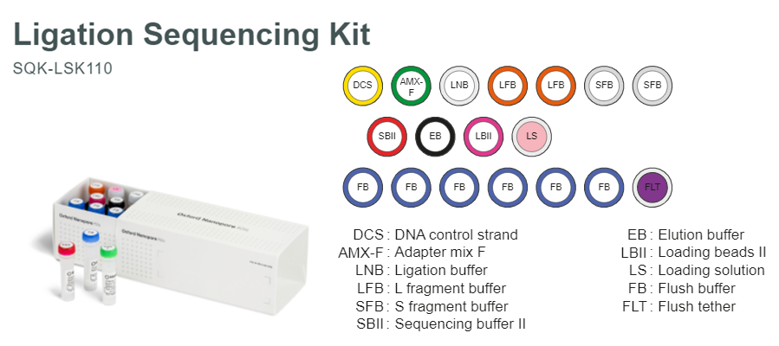
Keep an Eye Out & Troubleshooting Issues during library preparation:
Where is the Adapter Mix? What is SQK-LSQ110 Kit?
You will receive 2 MinION Enhanced package (ONT):

Slide 26



Sample quality – is crucial!! Contamination – your main enemy! Look sharp!!!

Slide 27



